Slide 1
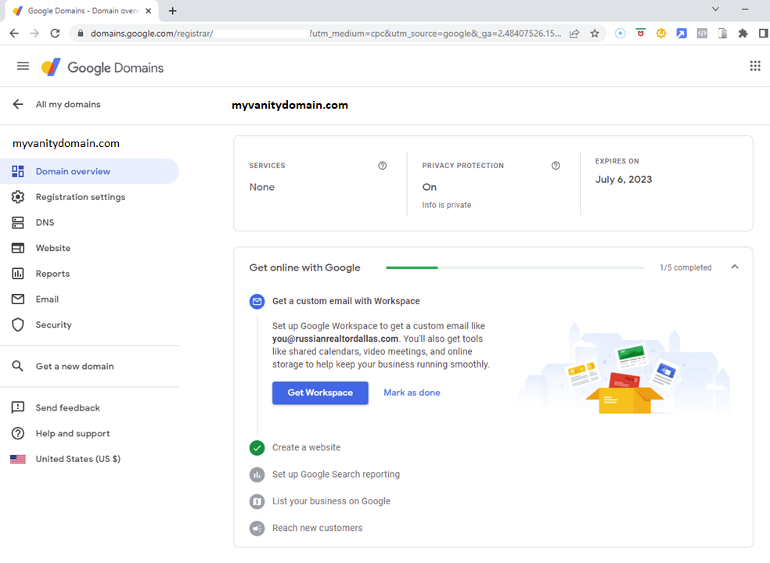
Notes:
Login to Google Domains and select the DNS option

Slide 2
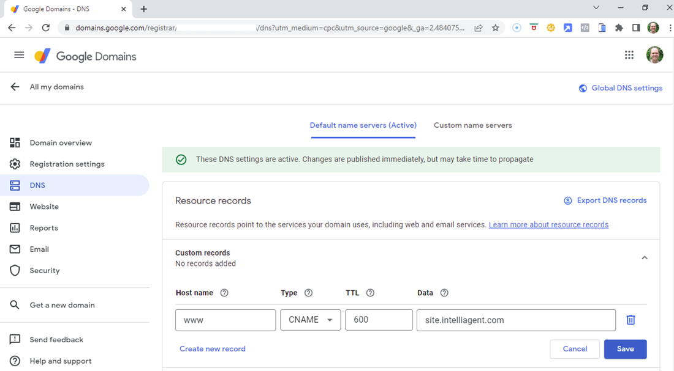
Notes:
Set the CNAME fields as described in Step 2a and Save

Slide 3
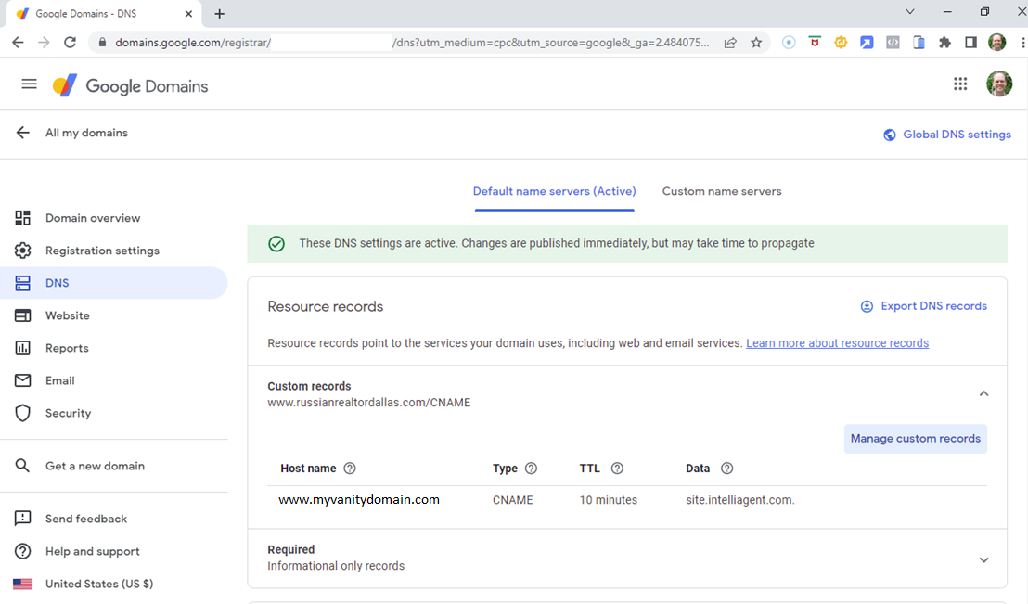
Notes:
To configure the forwarding as described in Step 2b, you will need to click on the Website option

Slide 4
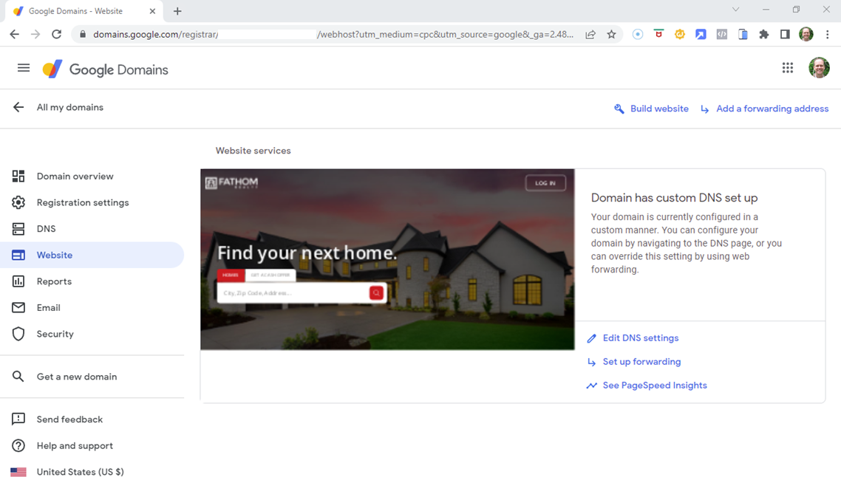
Notes:
Then click the Set up forwarding option

Slide 5
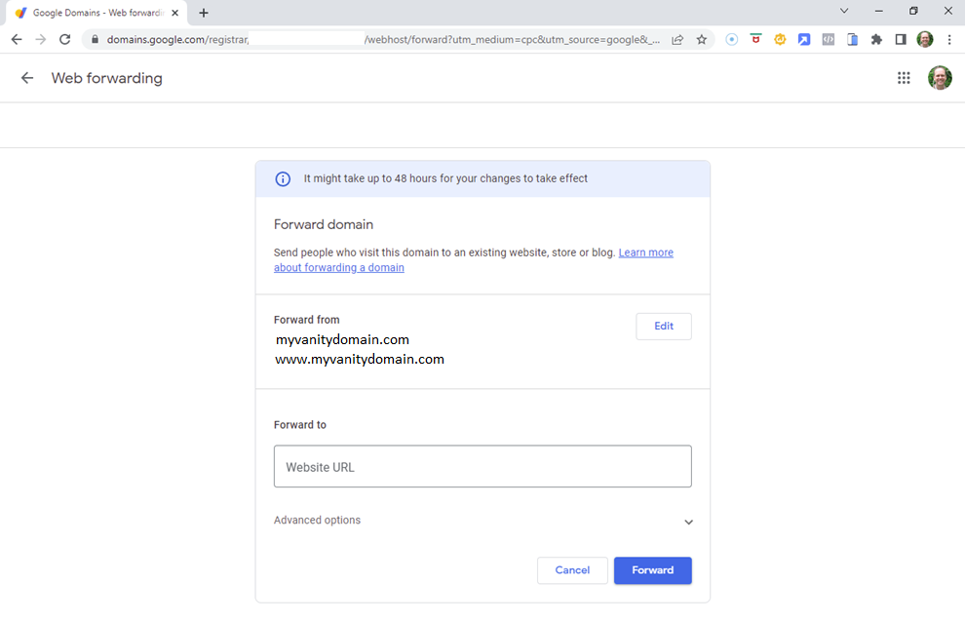
Notes:
Then in the Forward from section, click Edit

Slide 6
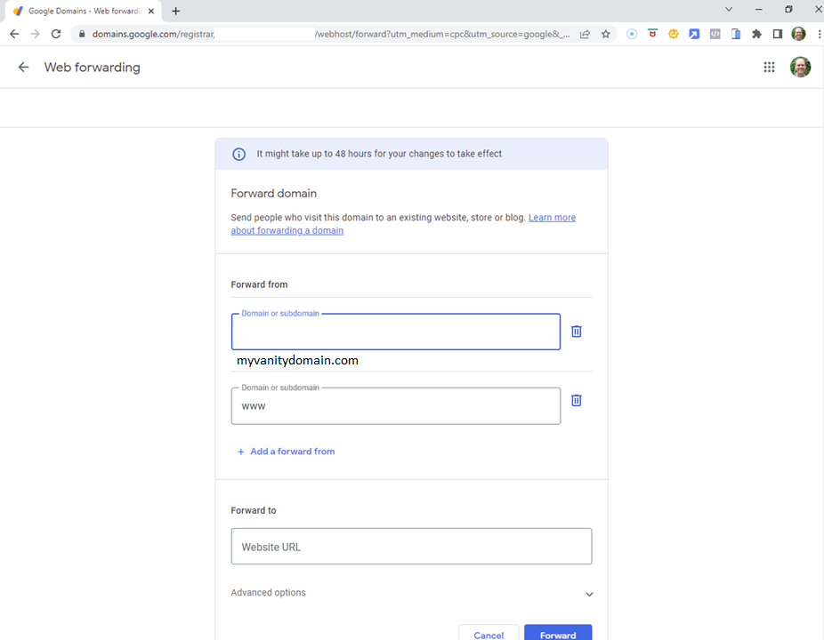
Notes:
Remove the www Domain or subdomain section by clicking the Delete icon

Slide 7
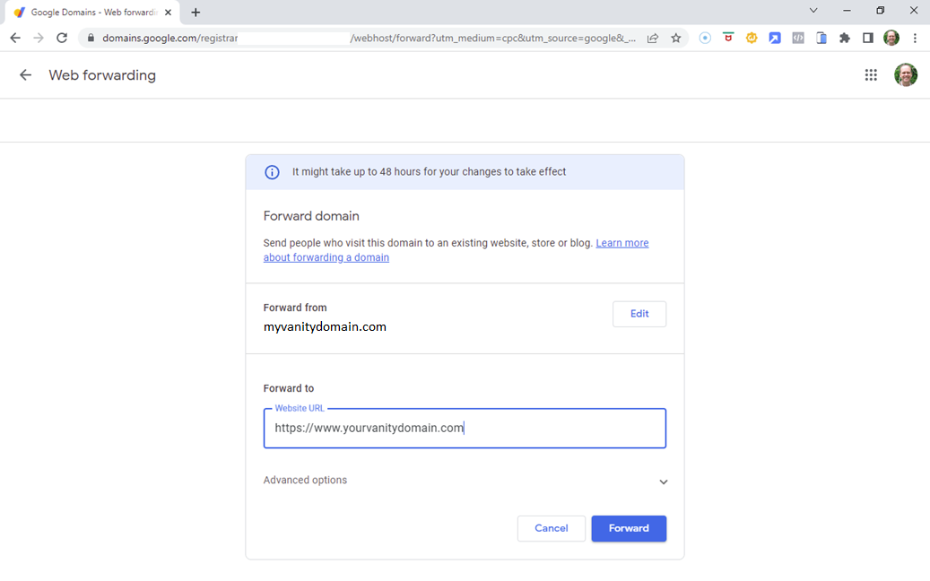
Notes:
In the Forward to section, add your https://www.yourvanitydomain.com URL then click on Advanced options

Slide 8
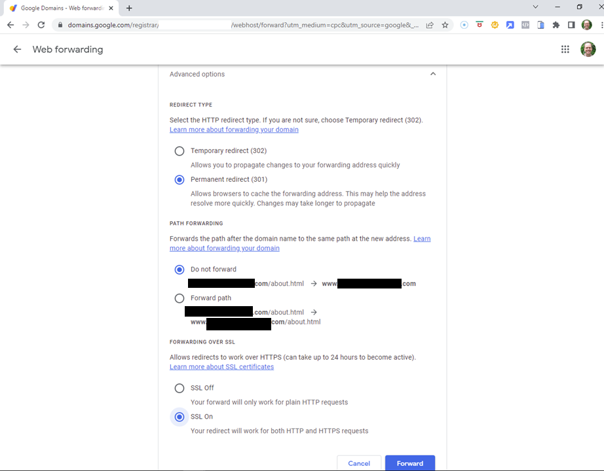
Notes:
Change Temporary redirect to Permanent redirect
Leave Do not forward as the selection
Change SSL Off to SSL On
Click the Forward button

Slide 9
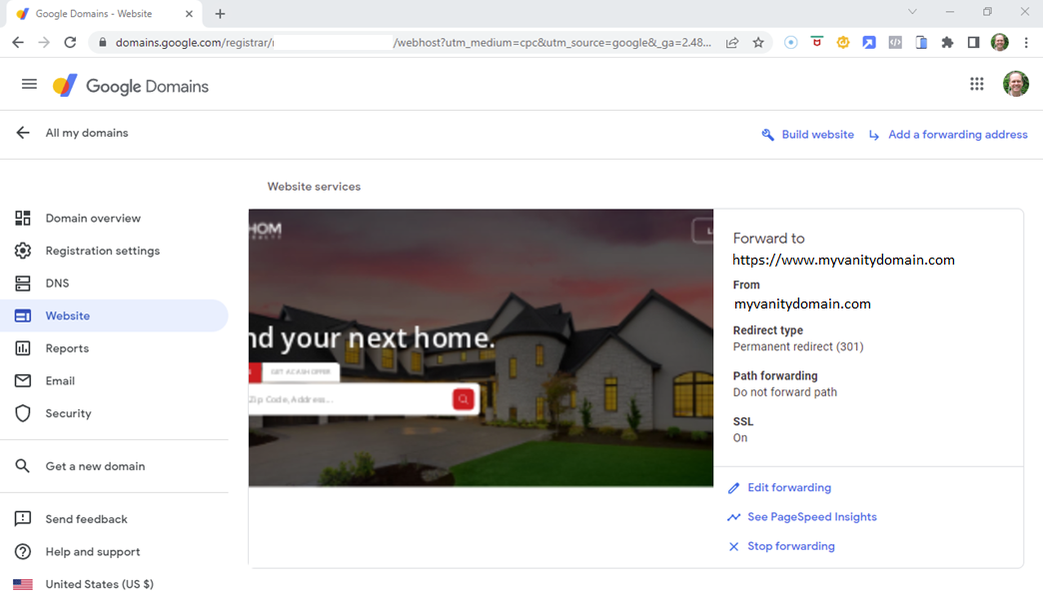
Notes:
Now you will see the Forward to settings

Slide 10
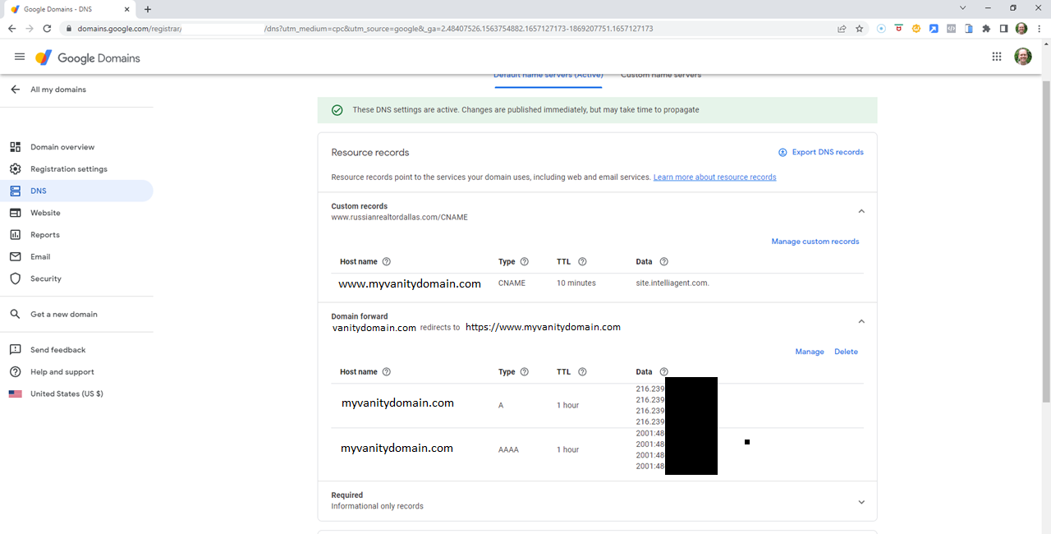
Notes:
Return to the DNS settings and you will see the new Domain forward section. Expand this to see the pre-filled records.

